Slide 1
“Waiting for my new Buddie”
Presidential Inauguration Campaign
June
2019

Slide 2
Opportunity
Promoting the 9th Presidential Inauguration with Agnes Scott Pride while honoring the Collegiate Environment of Agnes Scott College
Event
Community
Bring awareness via social media
Boost college brand
Promote Agnes Scott Pride
Honor traditions
Showcase innovative-forwards movements

Slide 3
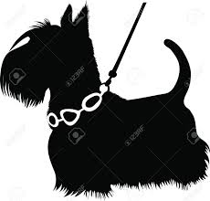
Scottie the Mascot
The beloved mascot is a focal point for the Agnes Scott Family

Slide 4
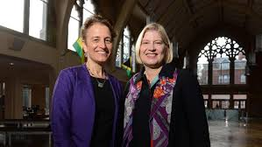
Presidents
Historical moment
Showing Strong Leadership
Festive Event
Former Preside Kiss and Incoming President Zak

Slide 5
Black Ring
Welcome to the Family
Important milestone and memorial of journey
Source of Pride
National and International community of students of all ages recognition

Slide 6
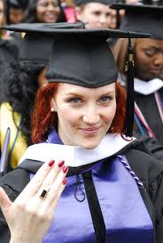
The Forever Sisterhood of the Black Ring

Slide 7
Value Proposition
Combination of Mascot, Event, and Alumnae pride
“Waiting for my new buddy, under the care of the Black Ring Mafia Sisterhood” campaign
External
Internal
Showcase campus life and accomplishments
Community Engagement
Awareness and honor to community members involvement in the college’s success.
Encourages participation of students, staff, and alumnae
Honors the milestone of present and past students
Provides opportunity to showcase the creativity of students

Slide 8
The Magic
The use of three powerful entities to showcase the historical to present academic greatness of the Agnes Scott environment with a popular theme. “The Gangsters of Education Sisterhood,” uses academic tools in place of weaponry.
Historical
Present
Alumnae from all over the world can participate
Showcases and honors the evolution of the student body to a more diverse environment
Opened in 1889 and shows strong stable leadership in only 9 presidents.
SEO alignment in the use of mascot (dog) and hashtags for social media platforms
Images of all ages and cultures of student body and groups. Ex: Woodruff Scholars, Grad Program and Black Agnes Scott Alumni.
Perspective students marketing and college branding

Slide 9
Social Media Communication Logistics and Audience
Social Media Platforms | Facebook | Twitter | Instagram
Content Used
#Hashtags | * | * | *
Event Information | * | * | *
Creative Images | * | * | *
Audience Identified | Social Media/Email | Flyers | Word of Mouth
ASC Faculty and Staff | * | * | *
ASC Trustees | * | * | *
ASC Undergraduates | * |  | *
ASC Alumnae | * |  | *
City of Decatur | * | * | *
Identify specific members of the Agnes Scott community as a call to action on digital platforms
Event Details
Participation/Submissions requirements

Slide 10
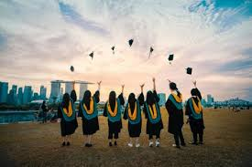
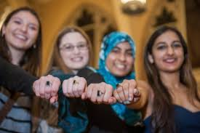
Social Media Content Samples
#LeadingEverywhere (Confirmed theme for inauguration)
“…Psst #ASCBlackRingMafia She’s chosen, it is time. (Request for photos)”
“Scotty’s wait in good hands (Pics with dog and ringed alumni)”
“Mafia Sighting (image and year of graduate)”

Slide 11
Timeline
8 week Campaign timeline to count down to the event
1/2
3
4
5
6
7/8
Call to action to target groups with the use of hashtags.
Team meets with faculty, departments, and staff to film internal submissions
First themed images posted with specific content.
Complete photos of internal images
Event countdown content to accompany hashtags and images in social media posts
Finish filming of interviews
Continued posts on social media sites
Create library of images on existing college web pages.
Continued posts on social media sites
Faculty, Staff, and incoming President interviews added to sites
Continued posts on social media sites.
Equipment returned
Wrap up of campaign and team members

Slide 12
Benchmarks
Centenary focused on fund raising: 31FOR31 Student Scholarship Campaign and campus landscape. No social media presence
Bennett focused art exhibit in conjunction with “Bennett Belles” with small mention of incoming president. One post on Facebook
Agnes Scott 9th Presidential Inauguration
Focus on President’s Accomplishments
Honor Alumnae
Strong Social Media Presence
College and Community Engagement

Slide 13
Budget
Equipment | Cost | Quantity | Total
Camera (s) Rental | $50.00 | 2 | $100.00
Props | $100.00 | n/a | 100.00
Costumes | $100.00 | n/a | 100.00
Microphones | $25.00 | 2 | 50.00
Laptops |  | 1 | 0.00
Printing | $50.00 |  | 50.00
Production Talent | $20 per hr | 10hrs | 200.00
Labor | $20.00 per hr | 25 hrs | 500.00
 |  | Total | $1050.00
This is an estimated budget for this campaign. Due its unique nature and theme the majority of equipment is available for checkout at the library as well as student talent to fill additional production talent slots.

Slide 14
Team
Project Campaign Manager assembles resources and directs team members.
Student Ambassadors works with faculty and staff to confirm participation and prepare schedule for photos and filming.
Creative Director and Photographer responsible for scene set up and shots. Directs the editing of pictures and films for approval and submission. Maintains equipment inventory
Social Media Manager manages the creation of social media posts and placement on Twitter, Instagram and Facebook.
Additional Staff (3) assists campaign heads, posts flyers, pose in pictures and more
The total of staff is 7 that are able to multi-task and complete requirement in allotted timeline.

Slide 15
Current Status
Awaiting an Opportunity

Slide 16
Thank You!
Monica Gresham
Digital Masters Grad Program
600WDC Web Portfolio
Email
gresham162@agnesscott.edu

