Slide 1
Honor the Elders
Human-Centered Design
Notes:
Thank you for joining us for our Sprint 3 Out brief presentation. We are team Honor the Elders.

Slide 2
Introduction
Carlee Beard
Sacha Comrie
Monica Gresham
Tyriq Jackson
Ingrid Rall
Notes:
I’m Sacha Comrie, this team’s Scrum Master. The rest of the team, is comprised of members Carlee Beard, Monica Gresham, Tyriq Jackson, and Ingrid Rall. With such a diverse group, we were able to draw from many unique individual perspectives and skills, to address the very important challenge of how to solve the problems associated with aging in place in the modern world. By utilizing an adaptive and agile process, commonly known as Scrum, we were able to empathize with the senior population. Through exhaustive research, interviews, and scrum methods (which we will explain more later in our presentation), we have met our specific design challenge with a solution that places the human at the center. Next my collegue Carlee Beard will give a detailed account of our Sprint 1 process.

Slide 3
Sprint 1
Understanding/Empathy
Seeing the world through another’s eyes
Notes:
The goal of human-centered design is to create solutions for the people who are going to use them. That is why, arguably, the most important part of the design process is Understanding/Empathy. To empathize with our clients, we conducted research and held interviews with people who are aging in place. This helped us understand their unique needs and helped us narrow down our focus. We started our empathy journey by conducting research on challenges that face the elderly. We knew that there would be physical challenges and financial challenges, but we also suspected that there were great inequities amongst seniors of varying demographics and income levels when it comes to aging in place safely and comfortably. Indeed, [look up author’s names] confirms that women, in general, continue to outlive men. Paired with the gender income disparity, women (especially women of color) are at a disadvantage for aging in place.

Slide 4
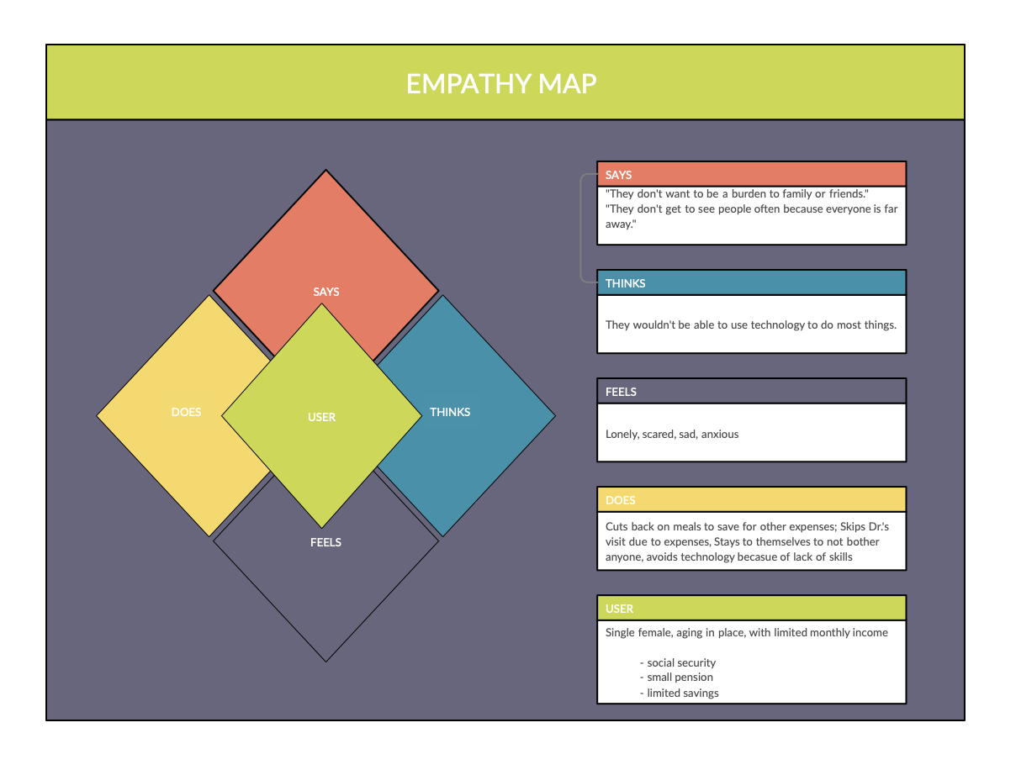
(empathy map here?)
Notes:
With this in mind, we focused interviews on women who are aging in place alone. Among our interviewees was Patricia, an African American widow living in Pittsburg, Pennsylvania. When asked about her social life, Patricia shared that she does not go out to socialize much anymore, She shared, “ I used to go every week to get my hair done, but because of the cost of the medicine, I can’t afford it anymore. The only way I communicate is on the phone.”
We were also honored to hear about Gary’s aging in place experience with his daughter, Joy. We are so thankful for all that they shared with us and the class. One thing that stuck out ot us from their story was that Gary has a good relationship with Joy and they can live peacefully together. That was not the case for our interviewees, including Patricia, whose family actually added to her isolation and financial burden.

Slide 5
Interviews
On socializing:
“I used to go out every week to get my hair done, but because of the cost of medicine, I can’t afford it anymore. The only way I communicate is on the phone.”
On technology:
On family:
“I have a brand new tablet and I’m still waiting for someone to show me how to get in and do things.”
“They feed me but I feel isolated in my room and we don’t talk much.”
Notes:
With this in mind, we focused interviews on women who are aging in place alone. Among our interviewees was Patricia, an African American widow living in Pittsburg, Pennsylvania. When asked about her social life, Patricia shared that she does not go out to socialize much anymore, She shared, “ I used to go every week to get my hair done, but because of the cost of the medicine, I can’t afford it anymore. The only way I communicate is on the phone.”
We were also honored to hear about Gary’s aging in place experience with his daughter, Joy. We are so thankful for all that they shared with us and the class. One thing that stuck out ot us from their story was that Gary has a good relationship with Joy and they can live peacefully together. That was not the case for our interviewees, including Patricia, whose family actually added to her isolation and financial burden.
Patricia was also asked how comfortable she is with technology, social media, email, etc. She responded saying, “I have a brand new tablet and I’m still waiting for someone to show me how to get in and do things. I have a smartphone and I use it to listen to gospel music. I don’t know the number, you have to call the house phone to talk to me. I have a laptop that is being used by grandchildren and children living with me. I never see it and they don’t show me anything on it. I have two facebook pages. The second one was created when I got a new phone and tried to access it. I created a new profile. I sometimes check my notifications, there has to be four million of them. I don’t like stranger’s friend requests. I don’t know those people and how do they know me?”

Slide 6
67%
Seniors age 65+ say they go online
Notes:
Seniors, like Patricia, are using technology. According to the Pew Research Center, 67% of seniors aged 65 and older say they go online. And 42% of seniors over 65 own a smartphone, and these numbers are only going to grow. However, like Patricia’s situation, many extended family members buy smartphones, tablets, or computers for their parents and grandparents but never take the time to teach them how to use them.

Slide 7
Problem Statements
“The effect of social group memberships on mortality [for those transitioning to retirement] was comparable to that of physical exercise.” - Steffens, et al.
How do we give seniors easy access to emotional support in the form of therapy or community to ensure that they have a sense of purpose and will to live?
What kind of programs can we create to give seniors a regular routine and encourage activity, mental/emotional stimulation, and incentive to face every day with a sense of purpose?
Notes:
This is where our research and the information collected from interviews comes together.
According to Steffens, et al., “The effect of social group memberships on mortality [for those transitioning to retirement] was comparable to that of physical exercise.”
Our research also tells us that having healthy social relationships is a significantly higher predictor of longevity and is associated with reduced rates of depression and better cognitive health.
If social-emotional health is so important, what is happening to our seniors who cannot easily leave the house because of physical limitations? Sure, they can connect with others over the phone, internet, or social media, but what if they cannot afford this technology? Or what if they have the technology but simply do not know how to use it?
We created these problem statements to guide us as we transitioned from sprint 1 into our second sprint, which Monica will describe for you.

Slide 8
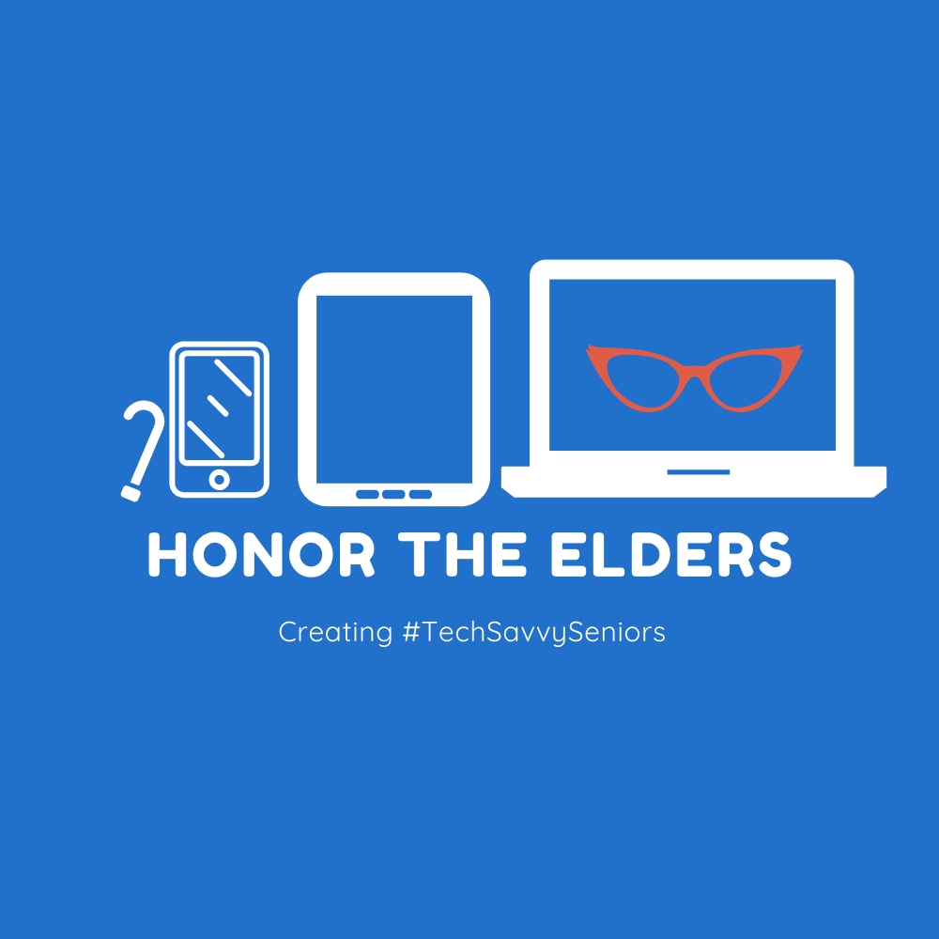
Sprint 2
Ideation, Inspiration and Insight
How might we educate our Elders?
Notes:
Thank you Carlee, as we have learned in Sprint 1, quality of life is dependant on communication and education. Whether a senior is mobile, immobile, a social butterfly or enjoys their own company, feelings of being left behind is apparent in the current technology age. In Sprint 2, we made sense of our research, identified opportunities for design and possible solutions. In the HDI Ideation Phase, the words of our interviewees guided the framework to create real impact for seniors aging in place by fulfilling their desire to become digital savvy and participating members in the Technology Age.

Slide 9
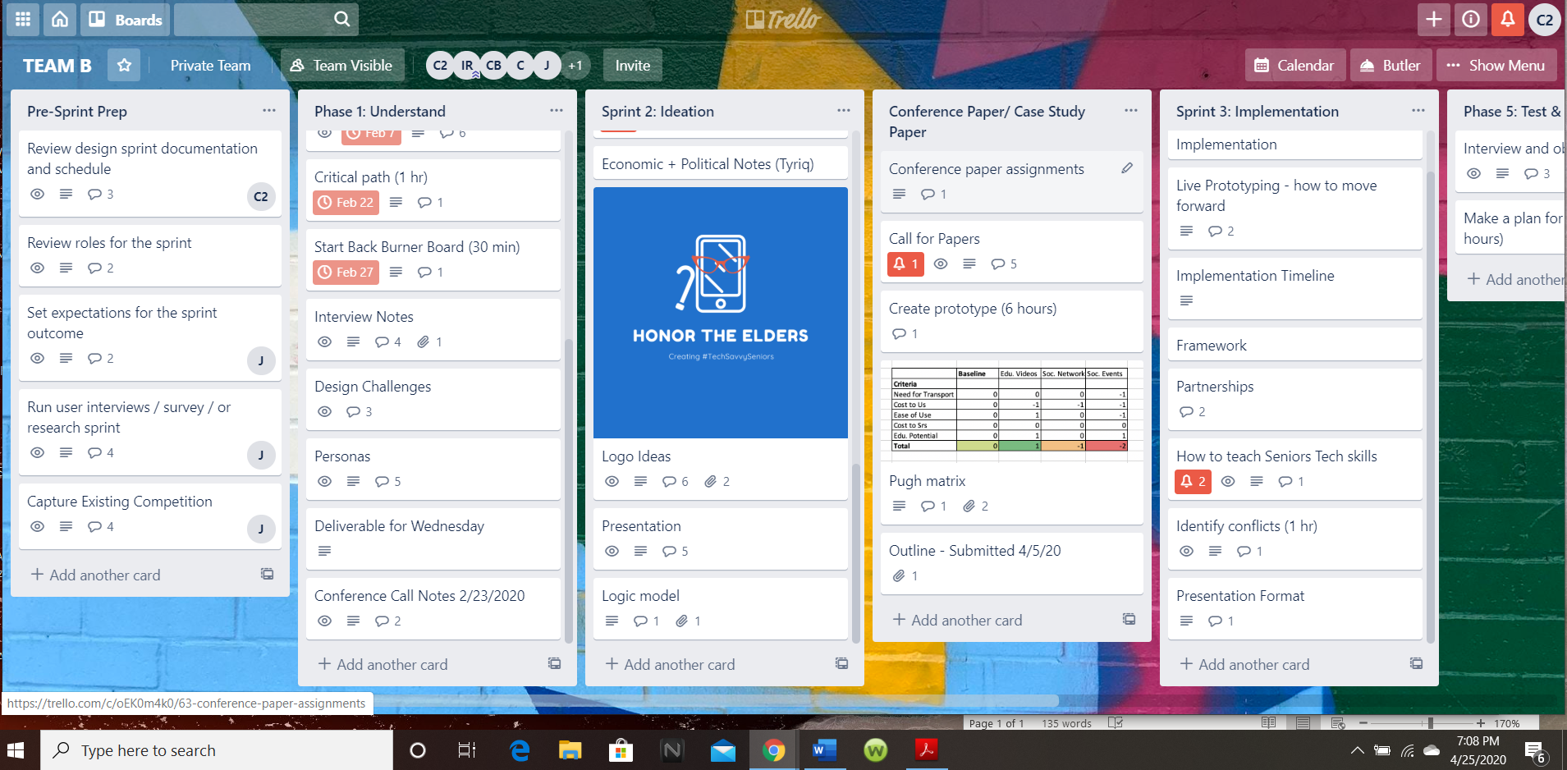
Communication and the SCRUM Board
Notes:
Communication has been essential in uniting HTE members and organizing research, ideas, and concepts during the design process. Trello, the Scrum Board created by Ingrid followed the Three C’s – Card, Conversation, and Confirmation of the scrum processes. The digital team room captured members participation, stored research and virtual notes for each phrase of the project. Tyriq setup virtual team meeting on Zoom every Sunday at 3pm. We used group texts and phone calls to share information, discuss assignments and inspire each other. We used Slack and Google Slides to share documents and collaborate in the design of our presentations. The Scrum Master, Sacha was able to track the design process and the information provided by members was used for individual tasks completion. The virtual team board proved its necessity in the coming weeks as we decided on a name, Ingrid created our logo and we stayed on course for assignments.

Slide 10
Inspiration and Insight
Design Challenge: Create a product or service that is easily understood and manipulated to enhance the quality of life for low income seniors in the technology age?
Insight: Technology Education and Social Lifestyles
Mission Statement: HTE is dedicated is enriching the social lifestyles of Seniors with an education in digital technology and inspiring closer relationships with family and friends.
Target Audience: Single women aging in place on a fixed income with little technical knowledge of digital devices and applications.
Target Location: Adamsville, Ga - low-income African American community with large senior population and several Senior Centers. Remote Location: Pittsburgh, Pa, - African American Suburb of Penn Hills
Personas: 5 - three single occupancy and two double (senior and caregiver)
Notes:
Sprint 1 and 2 showed the desire to learn within our senior communities and the lack of senior friendly digital educational platforms. With this insight, we focused on the combination of social lifestyles and education. Our initial framework focused on creating a network of existing Senior Centers to engage our target audience with fun digital activities and liaisons with local high schools for volunteers. These events would match a senior with a young educator to learn about their devices and social media platforms like Facebook, Instagram, and Snapchat. Client would take selfies with their teachers and share on platforms with hashtag #HonortheElders. Covid 19 tested our design challenge and forced HTE back to the Scrum Board as the world sheltered in place. In a quarantined environment, virtual communication is the only way to see friends and loved ones. It is dire that basic technical information is available for our seniors and in a format, best suited for their specific needs. HTE’s refined solution is an Educational Video Library. Next is Tyriq Jackson with Sprint 3 and prototypes

Slide 11
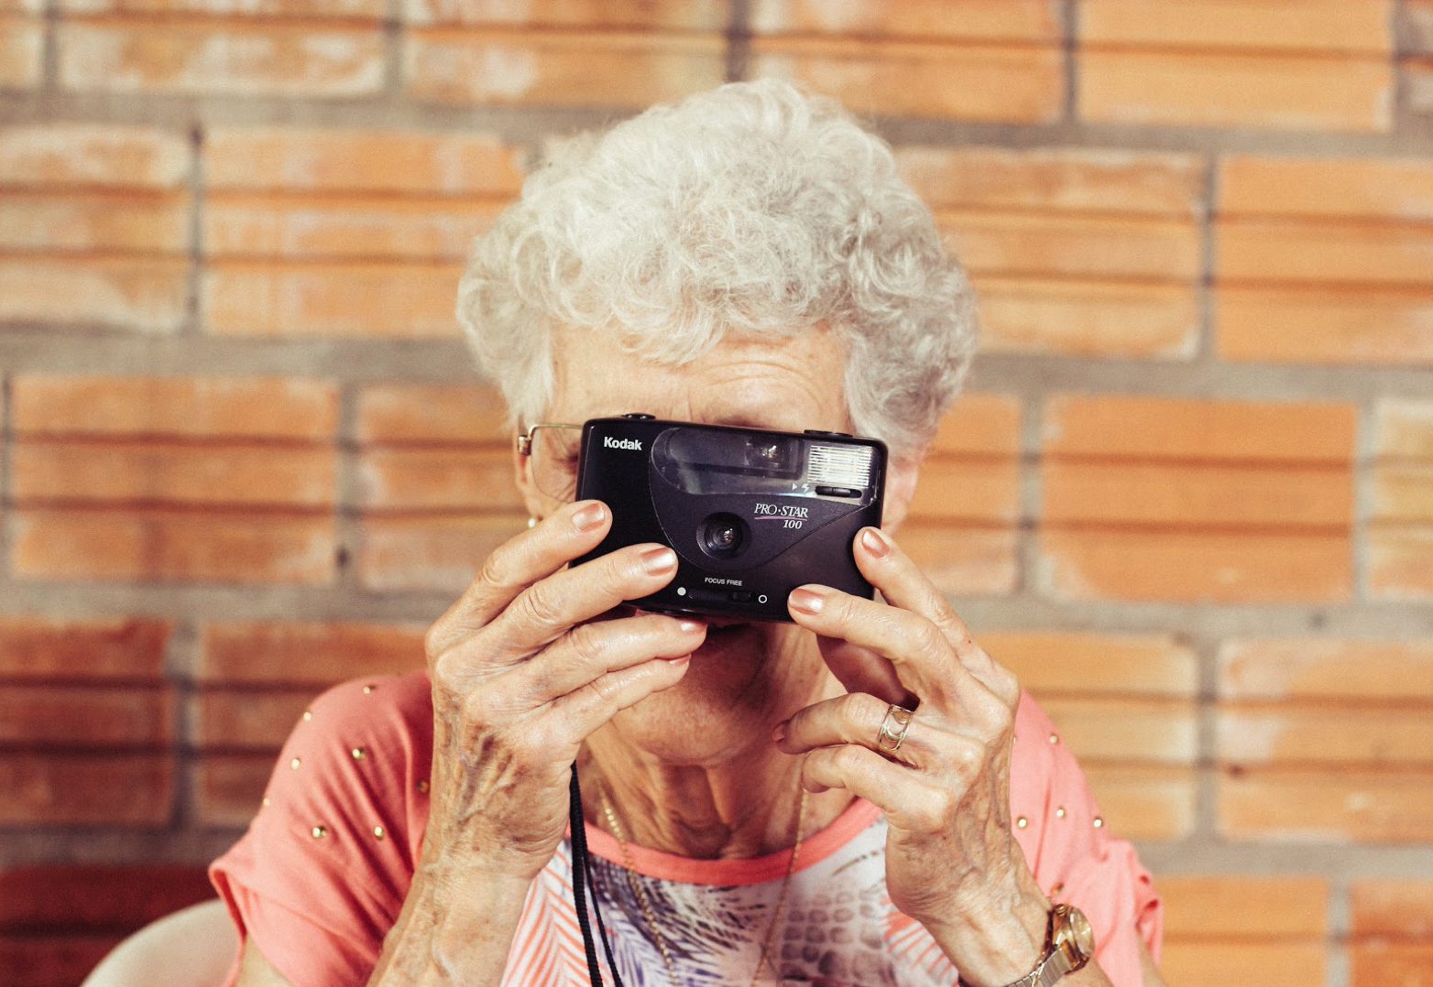
Sprint 3
Implementation

Slide 12
Partnerships
The program includes free educational videos, and access to a social network of senior centers. The pilot program includes: free entry into the pilot HTE application. Although free to use services, membership includes direct access to local HTE community leaders, health experts, organizations, and universities which provides exclusive offers to HTE members. Our overall goal is to equip seniors with modern technology in hopes of alleviating the social and emotional aspects of aging-in-place.
This program intends to implement a comprehensive approach for connecting seniors to technology, education, and social opportunities through an iPhone donation program. Through partnerships between local governments and organizations, we hope to attract potential investors to invest or donate to our program because of our mission.

Slide 13
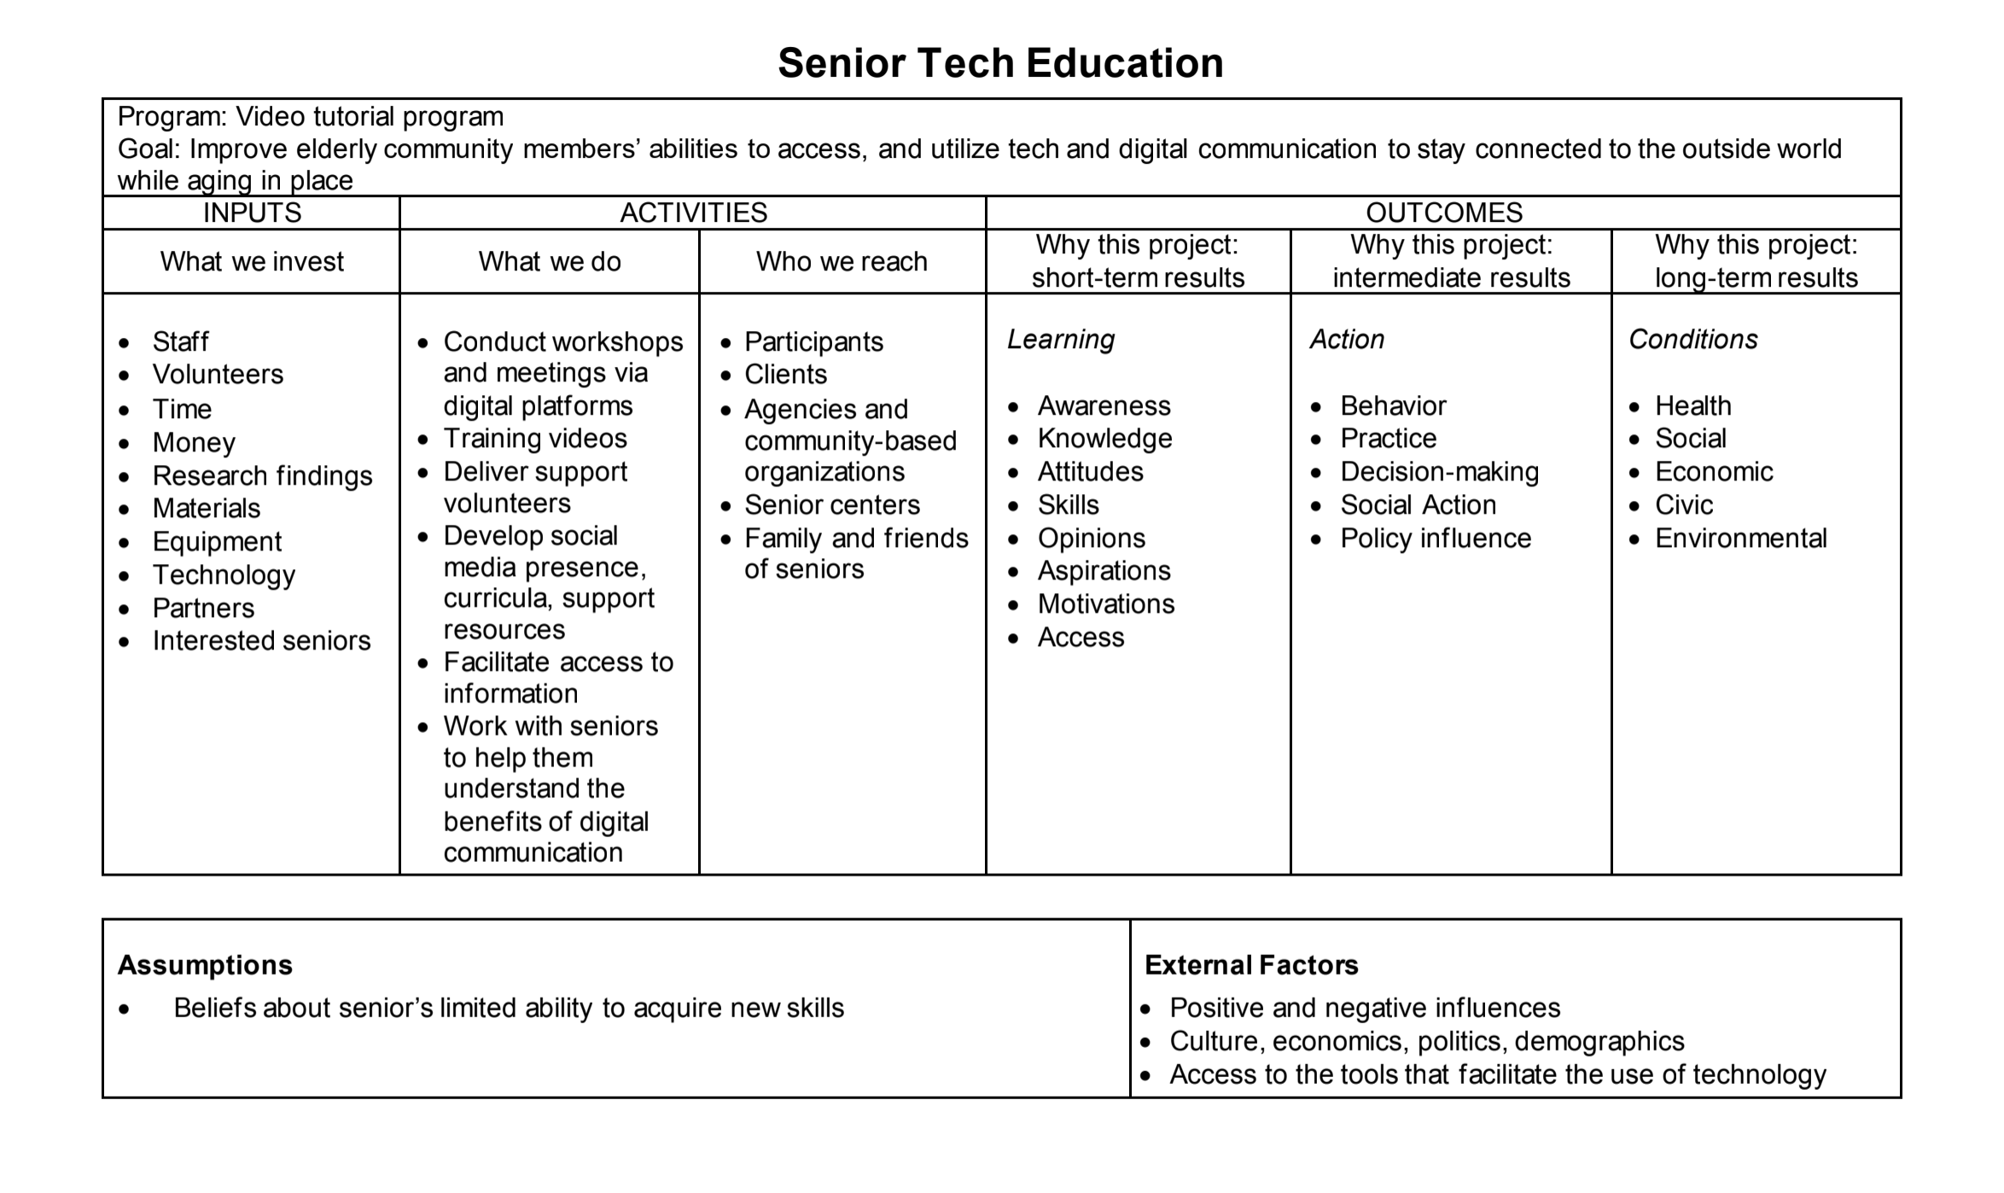

Slide 14
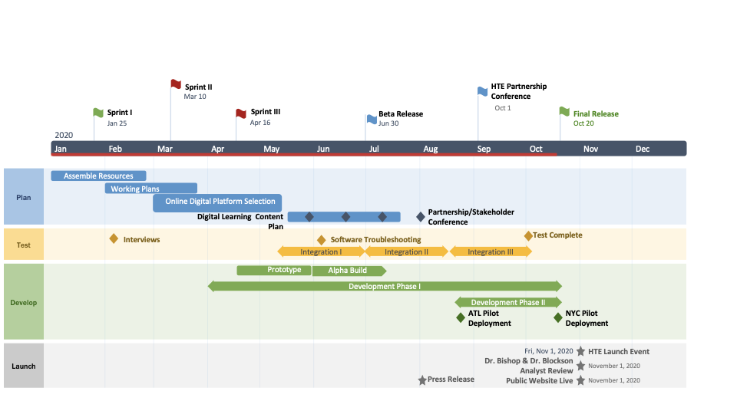

Slide 15
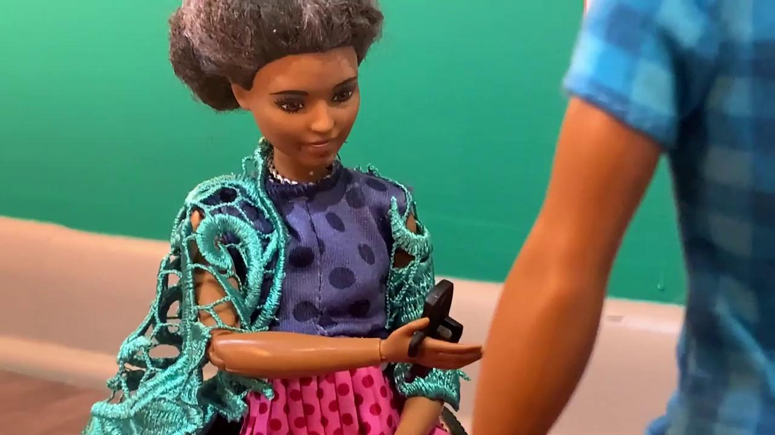
Prototype #1

Slide 16
Prototype #2

Slide 17
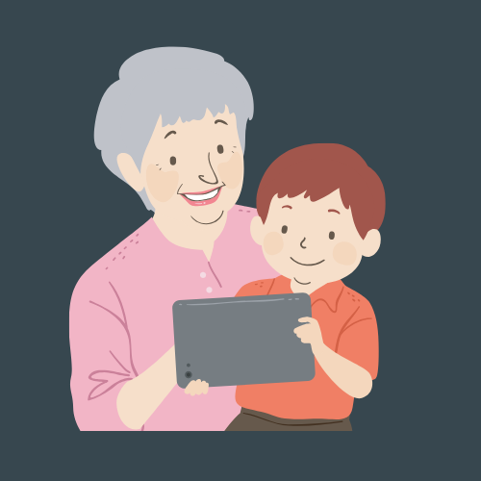
Conclusion
Elders want to learn and want to stay connected. They’ll learn best if the teaching is engaging, fun, and easy to understand.
Notes:
Over and over again, in our research, we saw a thread of older people wanting connection in the digital age, but not being quite sure how to get there. With what we’ve created, we hope to give seniors a leg up to learning about all these things their grandchildren won’t be quiet about, and then giving them the skills to actually participate if they choose. We want seniors to have a valuable tool for learning about things like social media, technology 101, and yes, even the perfect selfie, and we want them to find it accessible and even fun to learn, instead of frustrating. Team Honor the Elders is committed to helping seniors leap into the 21st century, and we’re going to provide the guide.

